Slide 1

TEAM 19
Yatin Singla (A20392685)
Vivek Sahu (A20375371)
Milind Mistry (A20377733)
Divyank Jain (A20384155)
Ankush Verma (A20405849)

Slide 2
INTRODUCTION
This is a web application allowing customers to rent a car based on the requirement.
The cars are categorized based on the car company, car category, and budget.
The administrator takes care of the overall backend activities.
The administrator is responsible for managing the vehicles and user information.
Customer can choose from the pool of available cars based on the selection made.

Slide 3
IMPLEMENTED FEATURES
Register and login before renting a car.
Provided with an interface where the customer can view featured cars.
Input location, start date and end date for the trip.
Filter the cars based on car type, company and price range.
Enter the credit card details and book the car.
Cancel the booking.
Add and View Review.
Rating the car.
Ajax Search Auto complete.
Manager can add cars.
Customer can view order history.

Slide 4
TO BE IMPLEMENTED
Trending
Manager can Update/Delete cars
Analytic Charts.

Slide 5
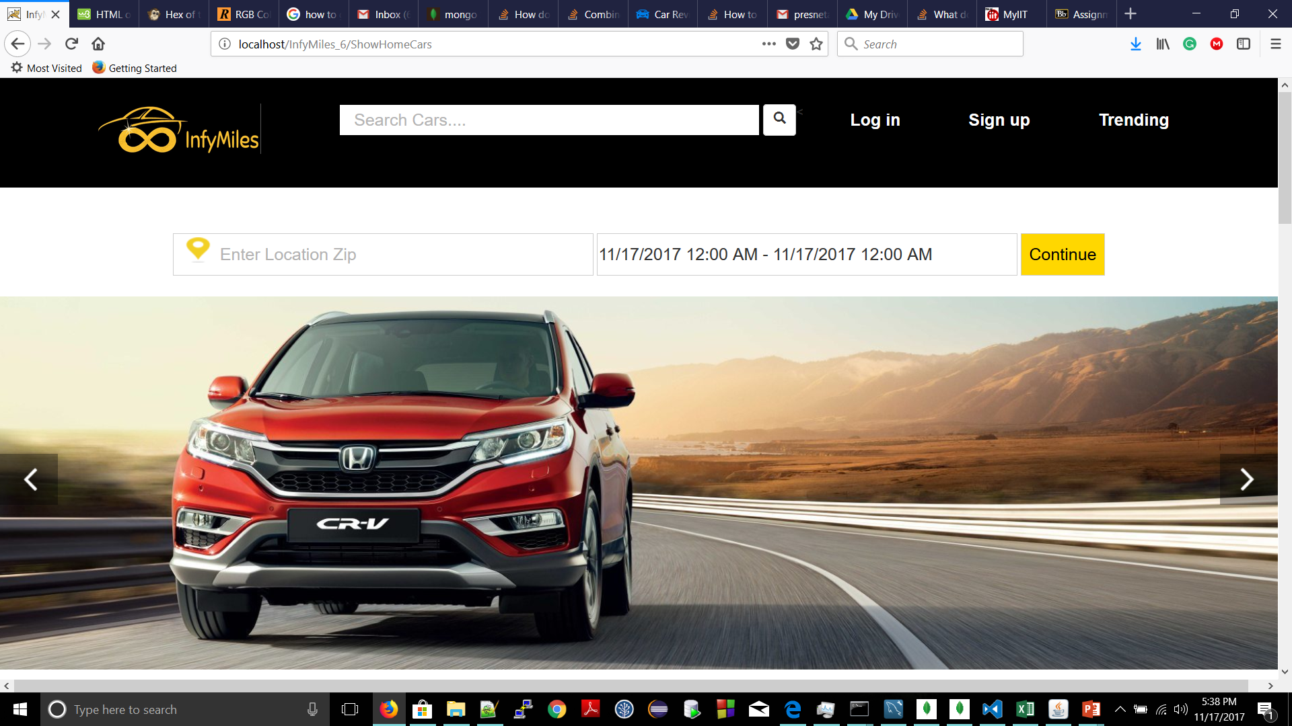
Home Page

Slide 6
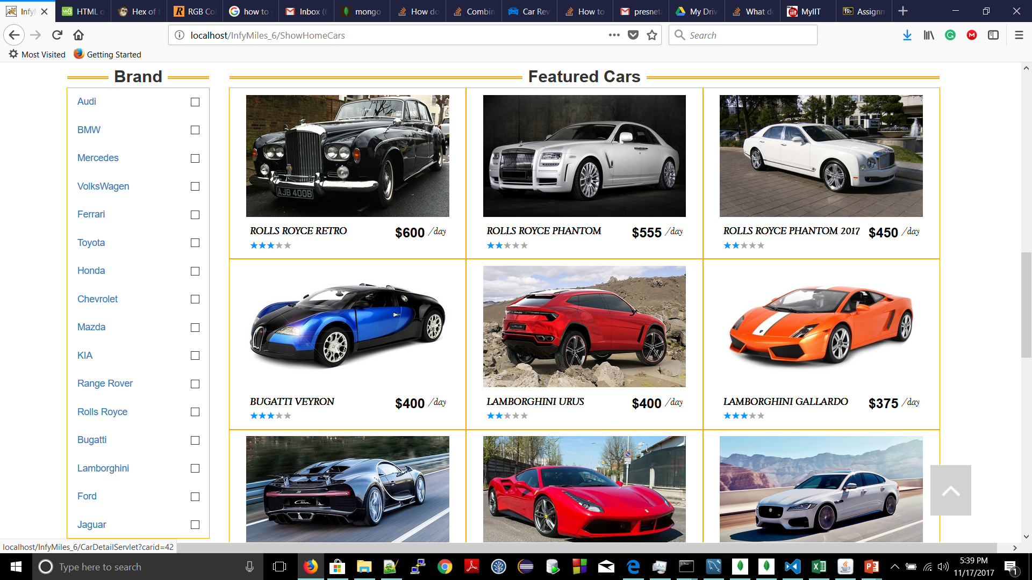

Slide 7
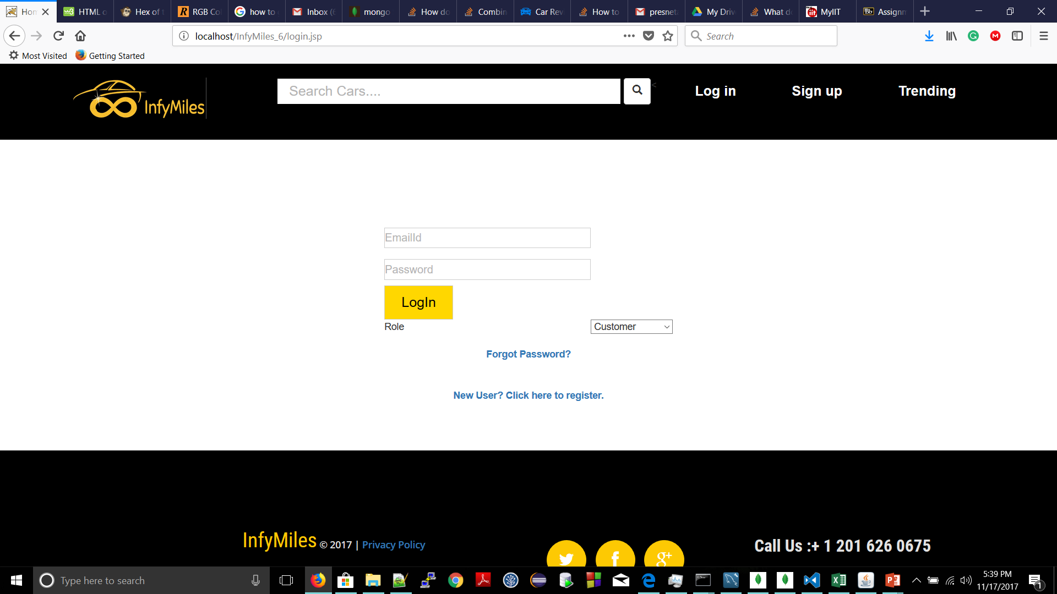

Slide 8
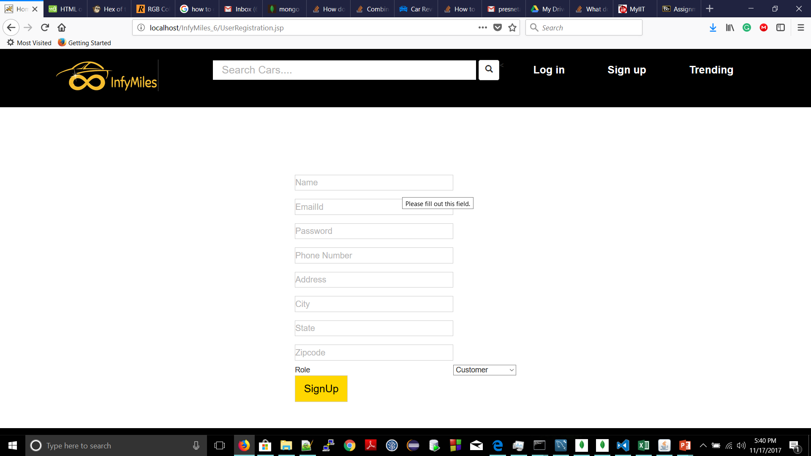

Slide 9
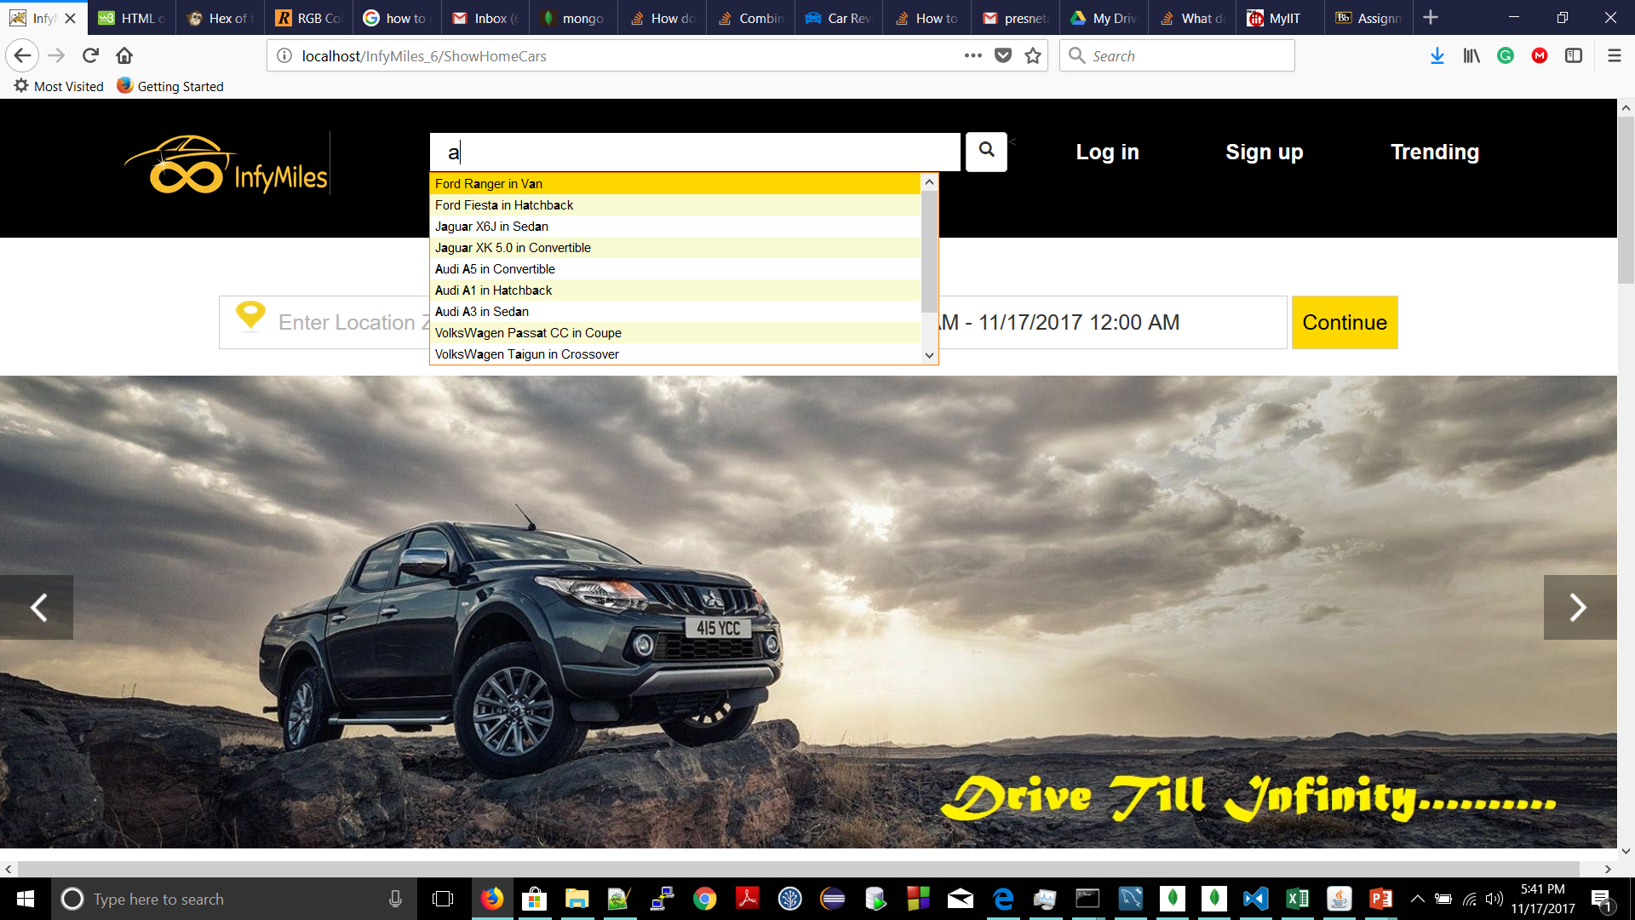

Slide 10
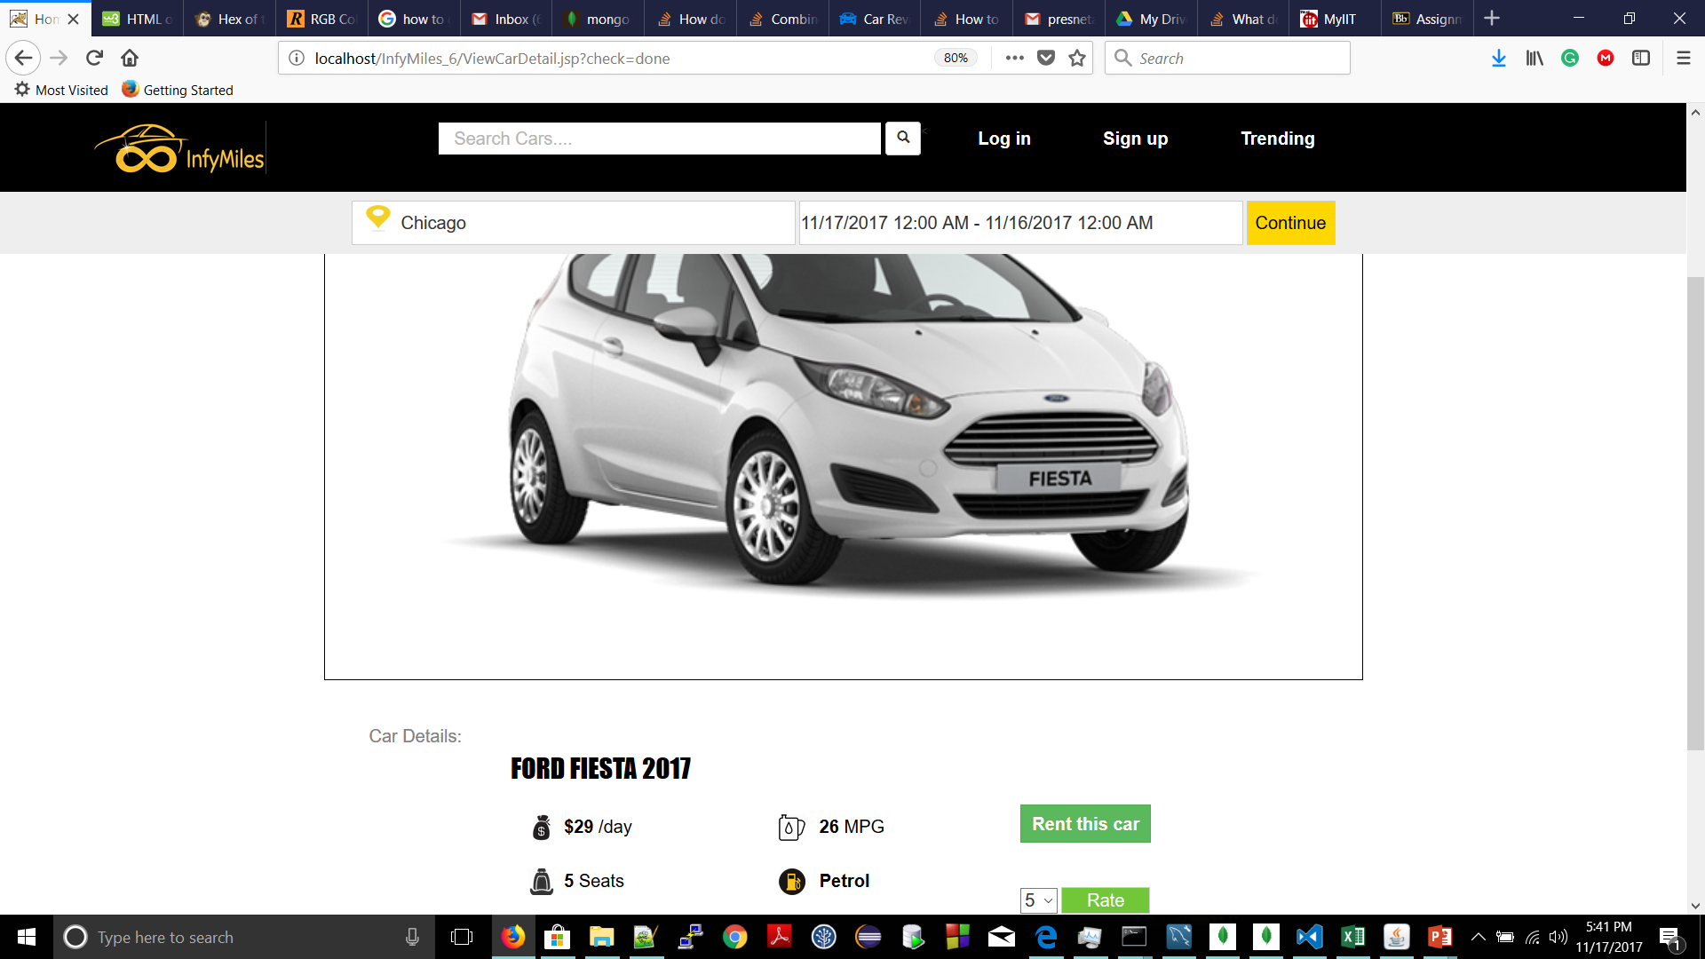

Slide 11
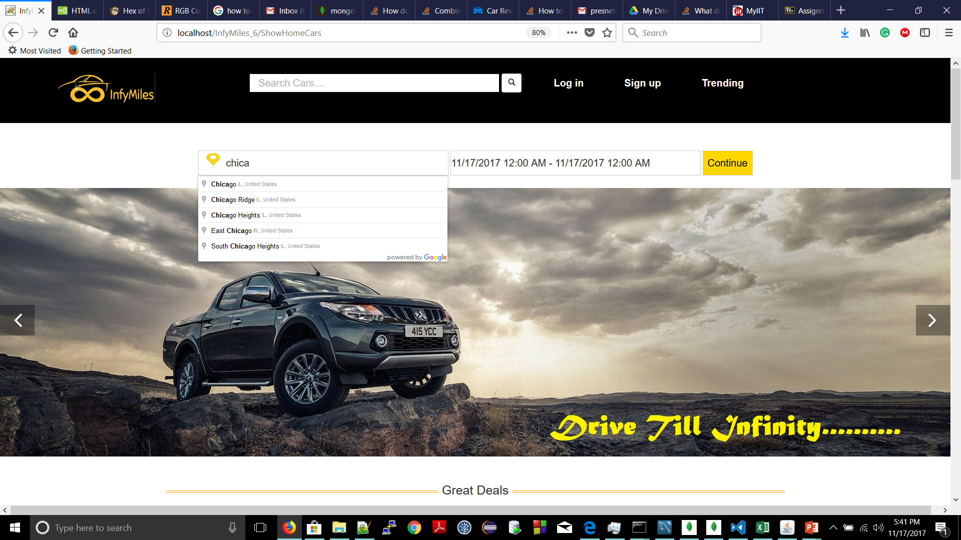

Slide 12
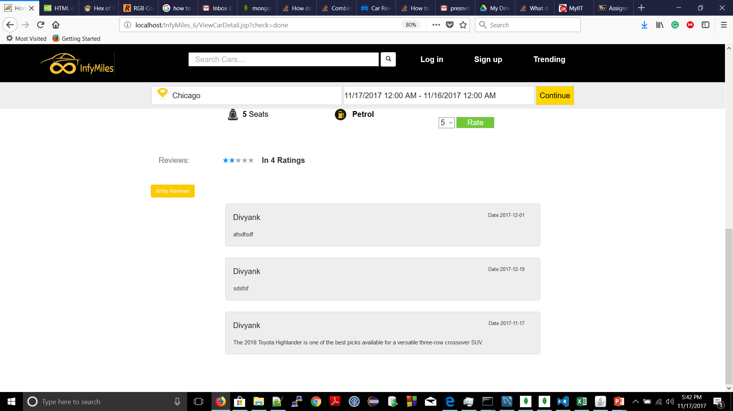

Slide 13
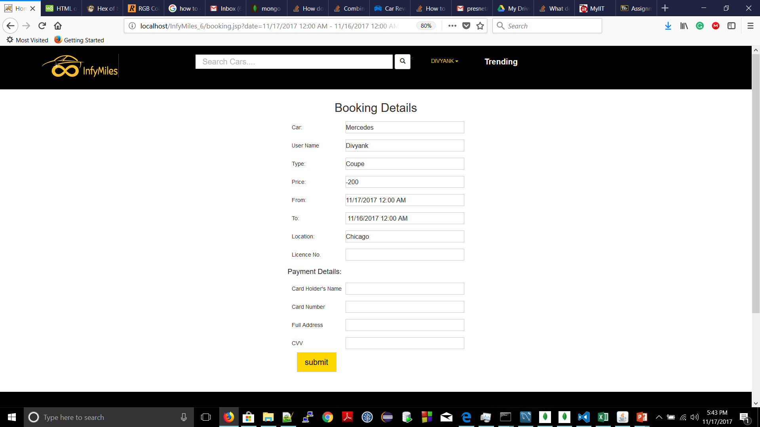

Slide 14
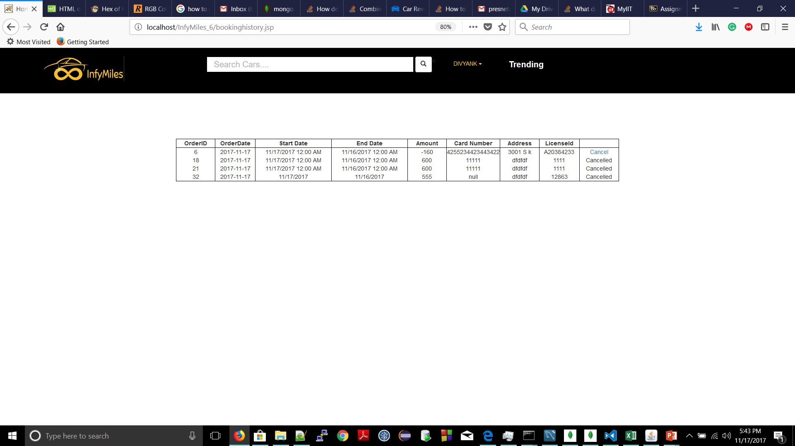

Slide 15
Thank You

